Slide 1
TechnoLogic – Human after all
Léonie Watson, TetraLogical

Slide 2

"Buy it, use it, break it, fix it”

Slide 3
"Trash it, change it, mail - upgrade it"

Slide 4
Implicit semantics
Most HTML elements have implicit semantics (role and state)

Slide 5
The <a> element
<a href=https://tink.uk>Tink.UK</a>
Role: link
Name: “Tink.UK”
State: focusable

Slide 6
The <img> element
<img src=“chamucos.png” alt=“A bottle of Chamucos tequila with the dancing devil logo”/>
Role: img or graphic
Name: “A bottle of Chamucos tequila with the dancing devil logo”
State: -

Slide 7
Neutral semantics
Some elements do not convey role or state

Slide 8
The <div> and <span> elements
<div>
<span class="button">
Add English Breakfast tea to basket</span>
</div>

Slide 9
"Charge it, point it, zoom it, press it"

Slide 10
Interactive elements
HTML has interactive elements that receive focus, including:
<a href=“…”>
<button>
<input>
<select>

Slide 11
DOM order
<button>1</button>
<button>2</button>
<button>3</button>

Slide 12
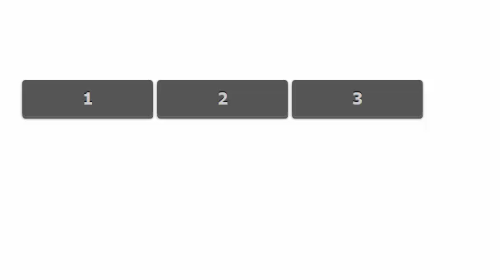
DOM order demo

Slide 13
Expected interaction
Interactive elements have expected interactions provided by the browser:
A link is activated by click, tap or the Enter key
A button is activated by click, tap or the Enter or Space key
An input is activated by click, tap or the Enter key

Slide 14
"Snap it, work it, quick - erase it“”

Slide 15
The <details> and <summary> elements
<details>
<summary>Tequila...</summary>
Makes me happy!
</details>

Slide 16
The accessibility tree
Role: button
State: focusable, focused, expandable, collapsed

Slide 17

Screen reader demo

Slide 18
Platform accessibility API
OS level accessibility API on Windows, MacOS, iOS, Android, and Linux
Accessibility API: a key to web accessibility:
https://smashingmagazine.com/2015/03/web-accessibility-with-accessibility-api/

Slide 19
"Write it, cut it, paste it, save it”

Slide 20
ARIA
Attributes that polyfill missing role, name, and state information for screen readers
ARIA 1.1 (W3C Recommendation)
https://w3.org/TR/wai-aria-1.1

Slide 21
The role attribute
70+ roles, including:
tablist, tab, tab
checkbox, radio, textbox
table, row, cell
toolbar, menu, menubar

Slide 22
The aria- attributes
45+ states and properties, including:
aria-invalid, aria-required
aria-pressed, aria-expanded
aria-controls, aria-owns

Slide 23
"Load it, check it, quick - rewrite it”

Slide 24
Reinventing a disclosure component
<span id="button">Tequila <span id="icon"></span></span>
<div id="content">Makes me happy</div>

Slide 25

Keyboard demo

Slide 26
The tabindex attribute
<span id="button" tabindex="0">Tequila <span id="icon"></span></span><script>
var button = document.getElementById('button');
button.setAttribute('tabindex', 0);
</script>

Slide 27
The role attribute
button.setAttribute('role', 'button');

Slide 28
The aria-expanded attribute
button.setAttribute('aria-expanded', 'false');

Slide 29
The aria-hidden attribute
icon.setAttribute('aria-hidden', 'true');

Slide 30
The hidden attribute
content.setAttribute('hidden', 'true');

Slide 31
The rendered code
<span id="button" tabindex="0" role="button"
aria-expanded="false" aria-controls="content">
Tequila <span id="icon" aria-hidden="true"></span>
</span>
<div id="content" hidden>Makes me happy</div>

Slide 32
Mouse interaction
button.addEventListener('click', disclose, false);

Slide 33
Keyboard interaction
button.addEventListener('keydown', function(event) {
if (event.keyCode == 13 || event.keyCode ==32) {
disclose();
}
});

Slide 34
Making it work
if (content.hasAttribute('hidden')) {
button.setAttribute('aria-expanded', 'true');
button.setAttribute('aria-controls', 'content');
content.removeAttribute('hidden');
}
else {
button.setAttribute('aria-expanded', 'false');
content.setAttribute('hidden', 'true');
button.removeAttribute('aria-controls');
}

Slide 35
Screen reader demo

Slide 36
"Lock it, fill it, call it, find it”

Slide 37
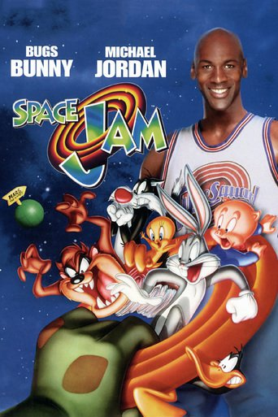
Space Jam

Slide 38
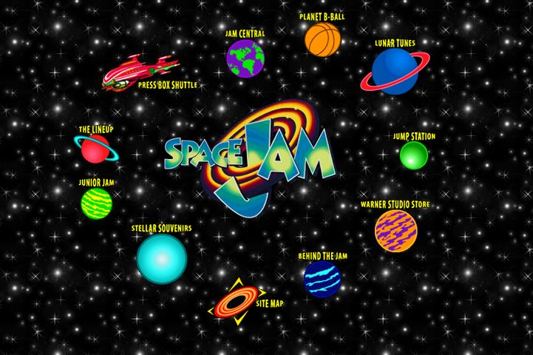
Space Jam website

Slide 39
Old-school code
<body vlink="#ff4c4c"
alink="#ff4c4c"
link="#ff4c4c"
text="#ff0000"
bgcolor="#000000"
background="img/bg_stars.gif">
...
</body>

Slide 40
Fixed in time
It's resilient, but:
No style override
No text resize
No layout flexibility

Slide 41
"Surf it, scroll it, pause it, click it”

Slide 42
The after selector
#a:after {
content: ' Makes me happy!';
}
...
<a href="/" id="a">Tequila!</a>

Slide 43
CSS2.1 on the before/after selectors
”Generated content does not alter the document tree. In particular, it is not fed back to the document language processor (e.g., for reparsing).”

Slide 44
DOM representation
<a href=“…” id=“a”>Tequila!</a>

Slide 45
"Name it, rate it, tune it, print it”

Slide 46
Screen reader demo
“Tequila, makes me happy! [link]”

Slide 47
"Touch it, bring it, pay it, watch it”

Slide 48
It doesn’t have to be perfect…
Just a little bit better than yesterday

Slide 49
Anthem for accessibility

